Slide 1
Функції і протоколи прикладного рівня
Спільне функціонування прикладного рівня, сеансового рівня та рівня та надання мережевих послуг для додатків кінцевих користувачів.
Протоколи прикладного рівня, які забезпечують послуги Інтернет для кінцевих користувачів, у тому числі послуги WWW та електронної пошти.
Протоколи прикладного рівня, які забезпечують IP-адресацію, у тому числі DNS і DHCP.
Протоколи прикладного рівня, які забезпечують обмін файлами, в тому числі: FTP, File Sharing Services, SMB.

Slide 2
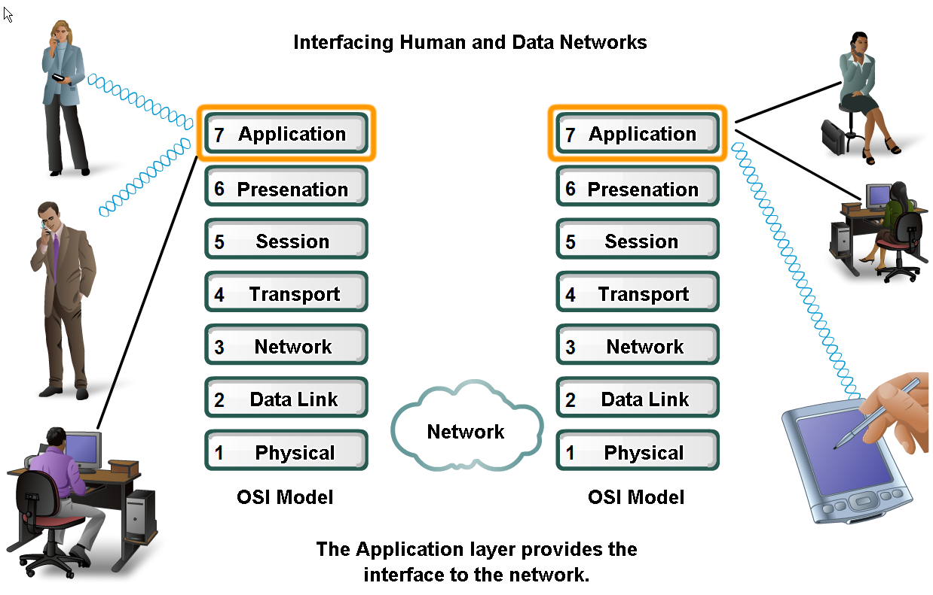
Прикладний рівень – інтерфейс між людиною та мережами
Прикладні програми генерують та отримують дані

Slide 3
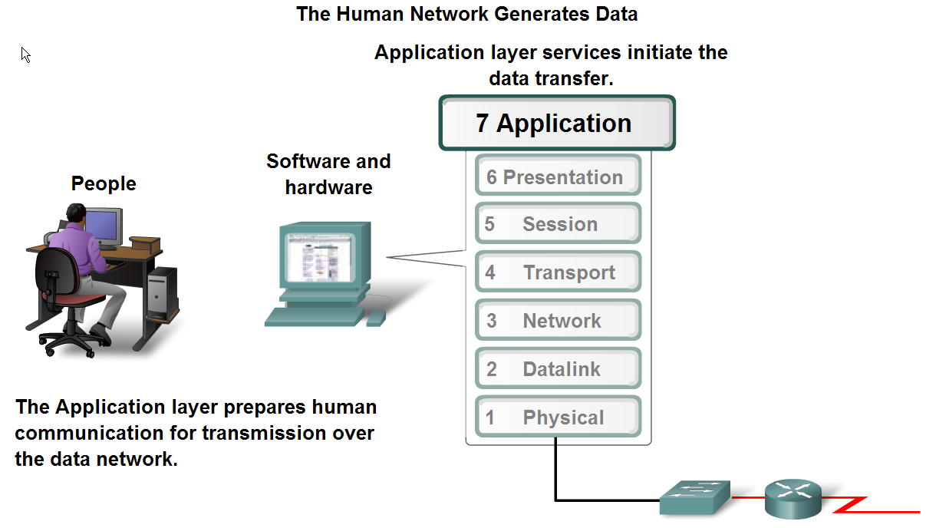
Прикладний рівень – інтерфейс між людиною та мережами
Прикладні програми, сервіси, протоколи

Slide 4
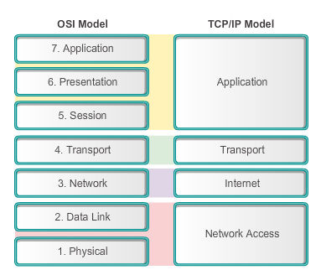
Application, Session and Presentation OSI and TCP/IP Models Revisited
The key parallels are in the transport and network layer.
Notes:
10.1.1.1
As shown in the figure, the application layer is the top layer of both the OSI and TCP/IP models. It is the layer that provides the interface between the applications we use to communicate and the underlying network over which our messages are transmitted. Application layer protocols are used to exchange data between programs running on the source and destination hosts.
Section 4.1.1.1

Slide 5
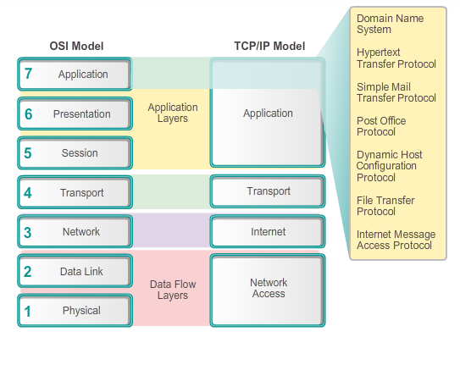
Application Session and Presentation Application Layer
Notes:
10.1.1.2
Most applications, like web browsers (using HTTP) or email clients (using SMTP and PoP), incorporate the functionality of the application, presentation and session layers.

Slide 6
Application, Session and Presentation Presentation and Session Layers
Presentation layer has three primary functions:
Coding and conversion of application layer data
Compression of the data
Encryption of the data for transmission and the decryption of data upon receipt by the destination
Session Layer
Functions create and maintain dialogs between source and destination applications
Handles the exchange of information to initiate dialogs, keep them active, and to restart sessions
Notes:
10.1.1.3

Slide 7
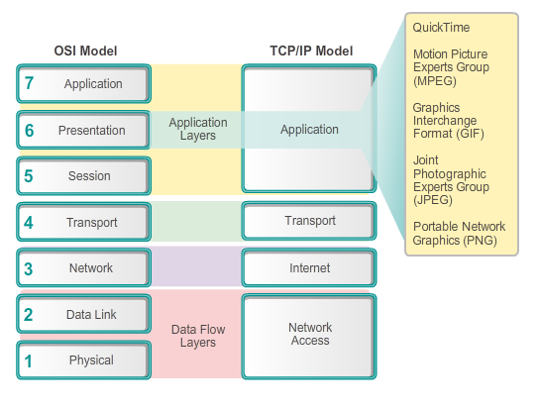
Application, Session and Presentation Presentation and Session Layers
Notes:
10.1.1.3

Slide 8
Application, Session and Presentation TCP/IP Application Layer Protocols
Domain Name Service Protocol (DNS) - used to resolve Internet names to IP addresses
Telnet - a terminal emulation protocol used to provide remote access to servers and networking devices
Bootstrap Protocol (BOOTP) - a precursor to the DHCP protocol, a network protocol used to obtain IP address information during bootup
Dynamic Host Control Protocol (DHCP) - used to assign an IP address, subnet mask, default gateway and DNS server to a host
Hypertext Transfer Protocol (HTTP) - used to transfer files that make up the Web pages of the World Wide Web
Notes:
10.1.1.4

Slide 9
Application, Session and Presentation TCP/IP Application Layer Protocols
File Transfer Protocol (FTP) - used for interactive file transfer between systems
Trivial File Transfer Protocol (TFTP) - used for connectionless active file transfer
Simple Mail Transfer Protocol (SMTP) - used for the transfer of mail messages and attachments
Post Office Protocol (POP) - used by email clients to retrieve email from a remote server
Internet Message Access Protocol (IMAP) – another protocol for email retrieval
Notes:
10.1.1.4

Slide 10
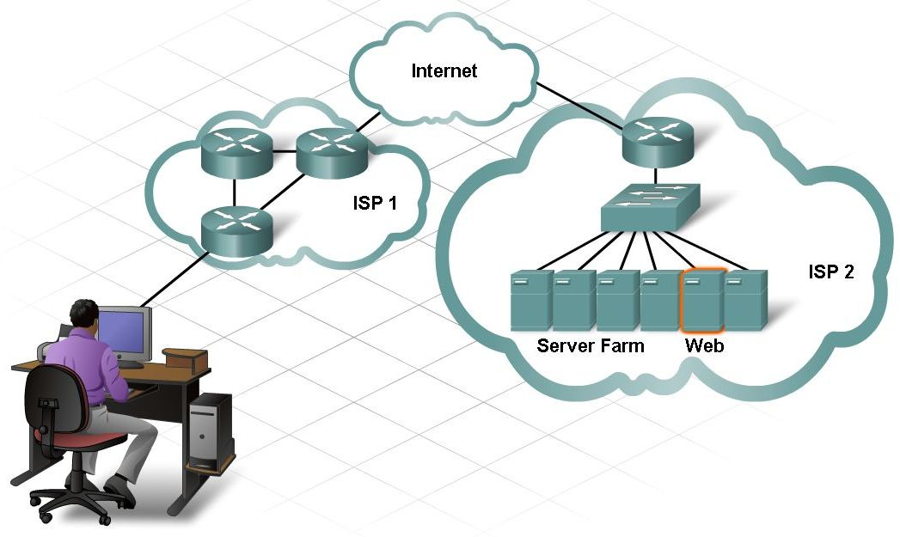
Клієнт-серверна технологія
Принцип роботи клієнт-сервер

Slide 11
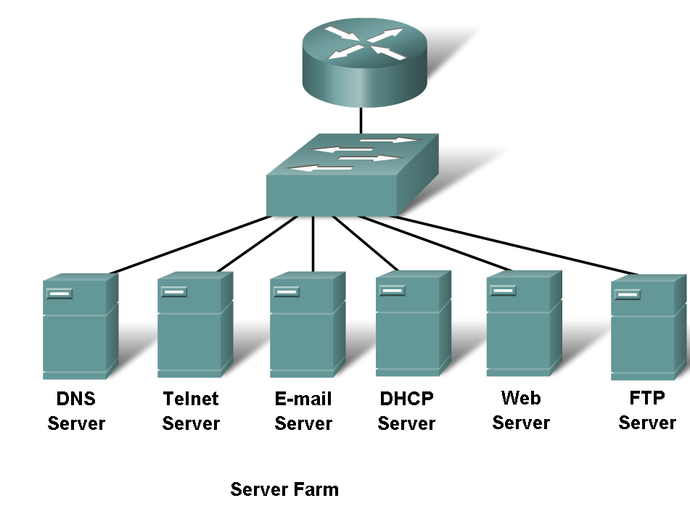
Клієнт-серверна технологія
Основні мережеві сервіси

Slide 12
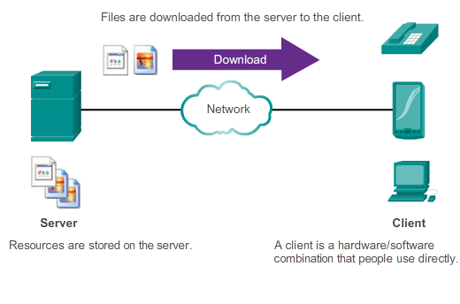
How Application Protocols Interact with End-User Applications Client-Server Model
Notes:
10.1.2.5
In the client-server model, the device requesting the information is called a client and the device responding to the request is called a server. Client and server processes are considered to be in the application layer. The client begins the exchange by requesting data from the server, which responds by sending one or more streams of data to the client

Slide 13
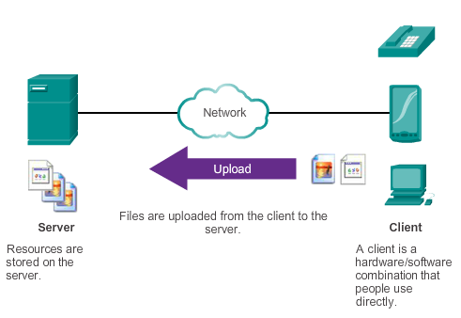
How Application Protocols Interact with End-User Applications Client-Server Model
Notes:
10.1.2.5
In the client-server model, the device requesting the information is called a client and the device responding to the request is called a server. Client and server processes are considered to be in the application layer. The client begins the exchange by requesting data from the server, which responds by sending one or more streams of data to the client

Slide 14
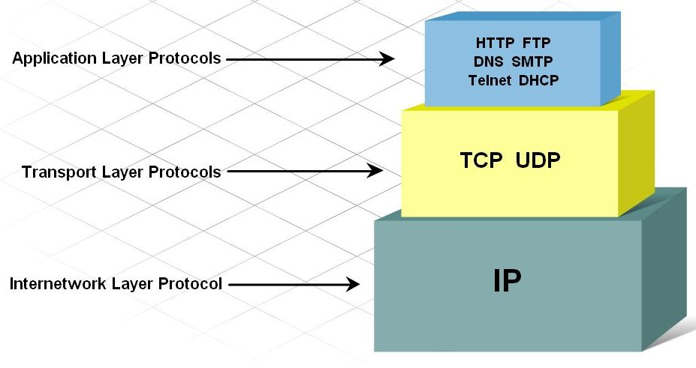
Протоколи “клієнт-сервер”
Протоколи прикладного, транспортного, міжмережевого рівнів та протоколи доступу до мережі.

Slide 15
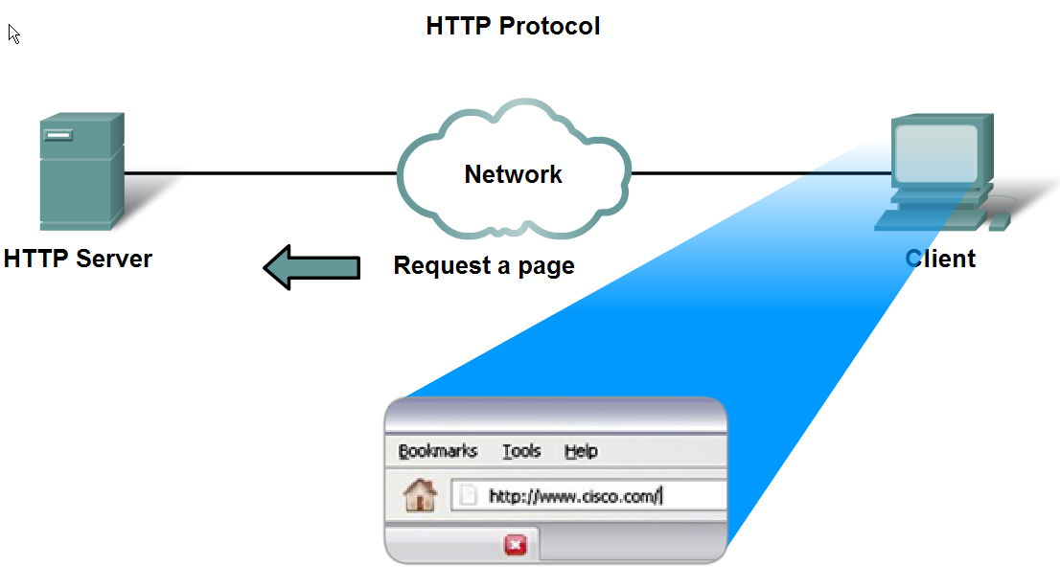
Типи взаємодій інтернет-додатків
Принцип роботи HTTP протоколу

Slide 16
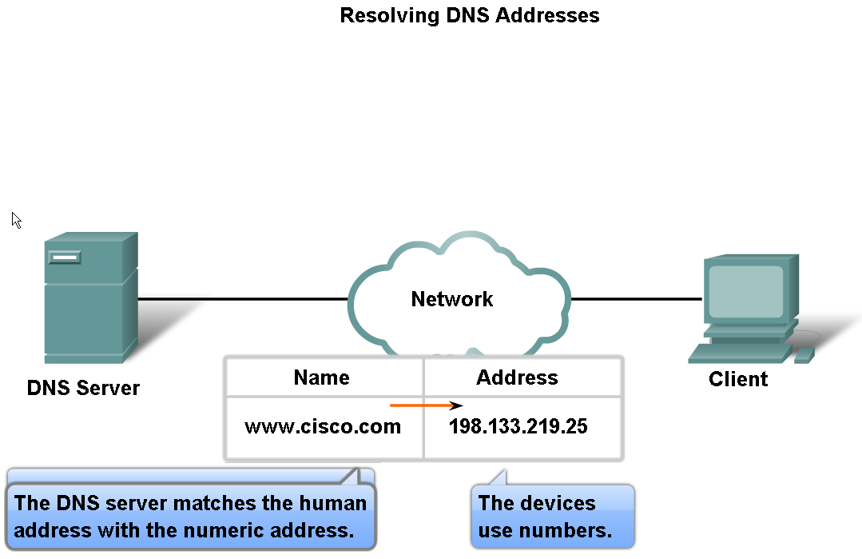
Типи взаємодій інтернет-додатків
Призначення DNS

Slide 17
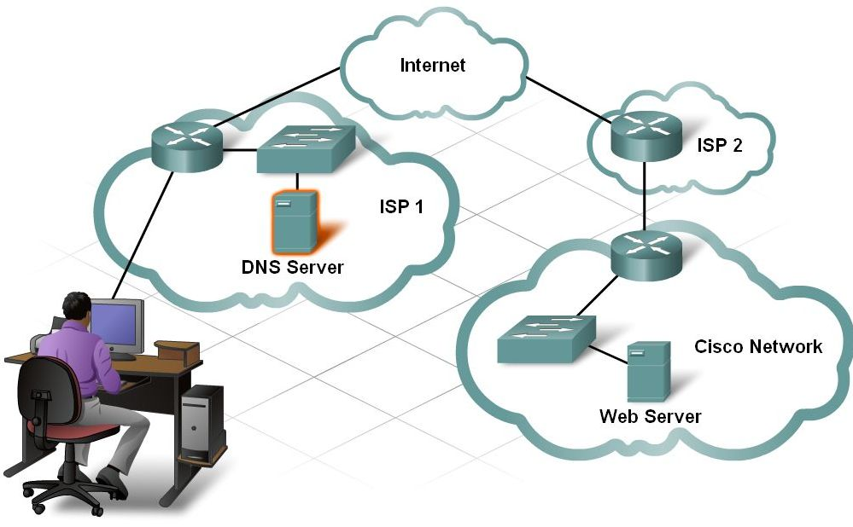
Типи взаємодій інтернет-додатків
Взаємодія між веб-клієнтом та веб-сервером

Slide 18
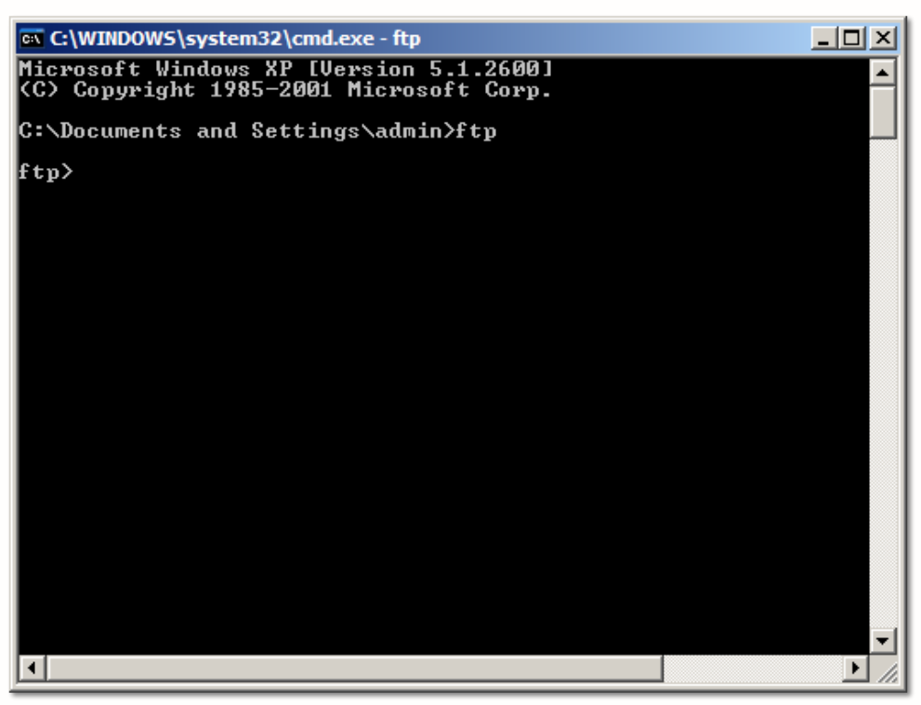
Типи взаємодій інтернет-додатків
Взаємодія між FTP клієнтом та FTP сервером

Slide 19
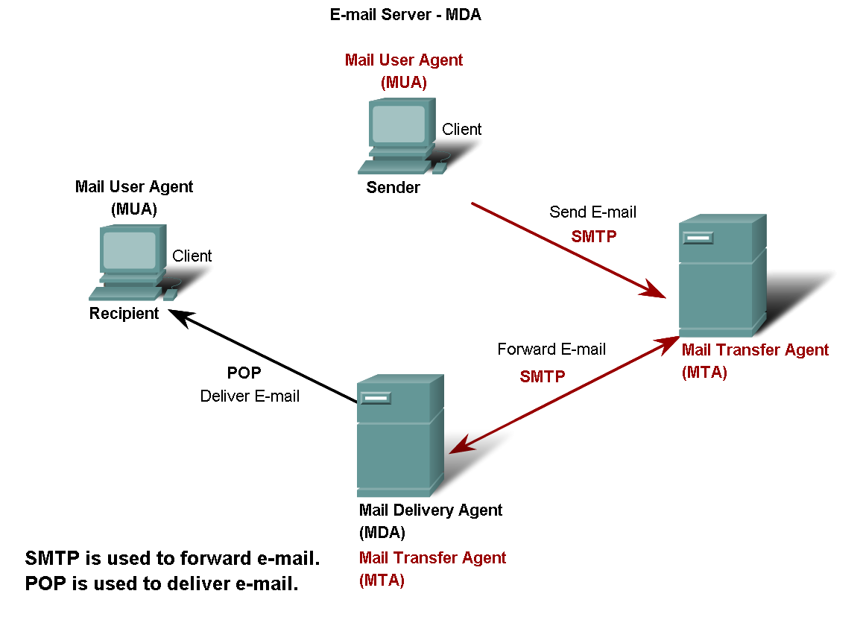
Типи взаємодій інтернет-додатків
Протоколи електронної пошти: POP та SMTP

Slide 20
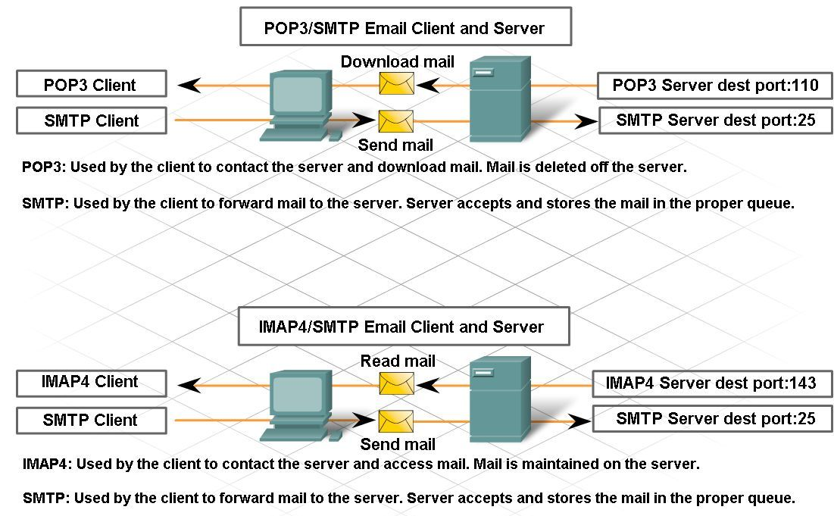
Типи взаємодій інтернет-додатків
Взаємодія між поштовим клієнтом та поштовим сервером

Slide 21
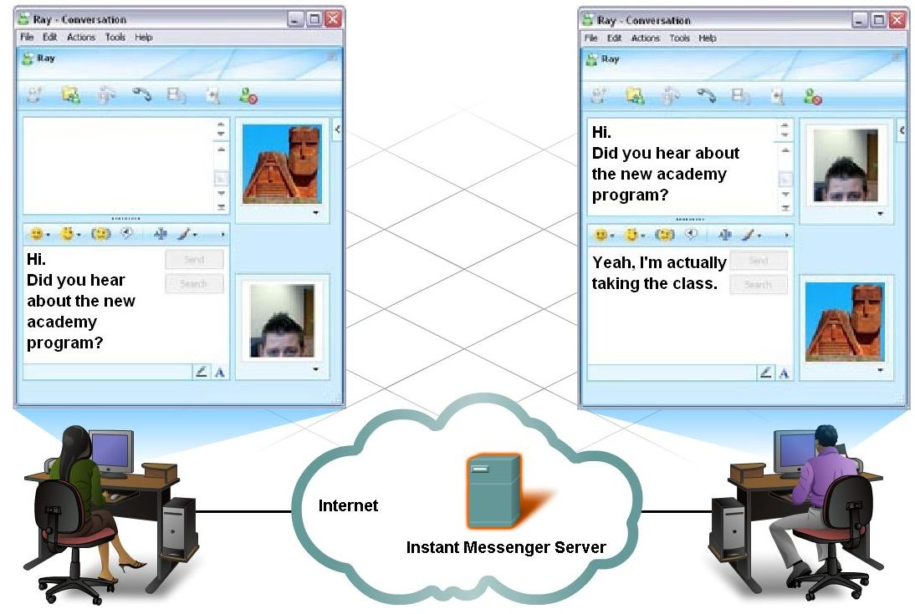
Типи взаємодій інтернет-додатків
Взаємодія між IM / Peer-to-Peer клієнтом та поштовим сервером

Slide 22
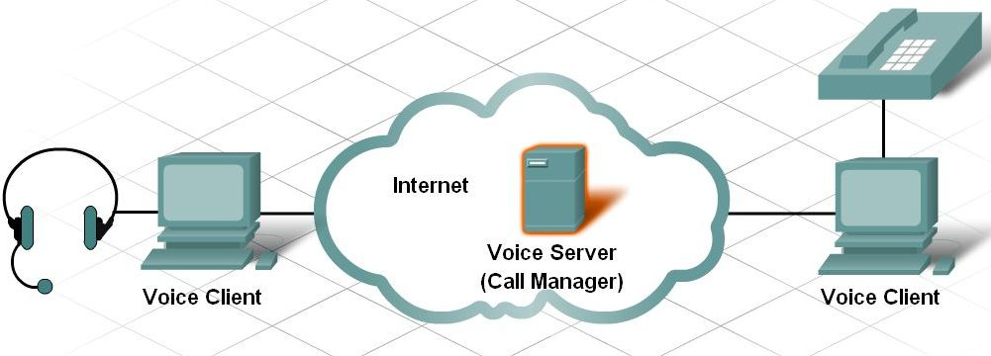
Типи взаємодій інтернет-додатків
Взаємодія між голосовим клієнтом та сервером

Slide 23
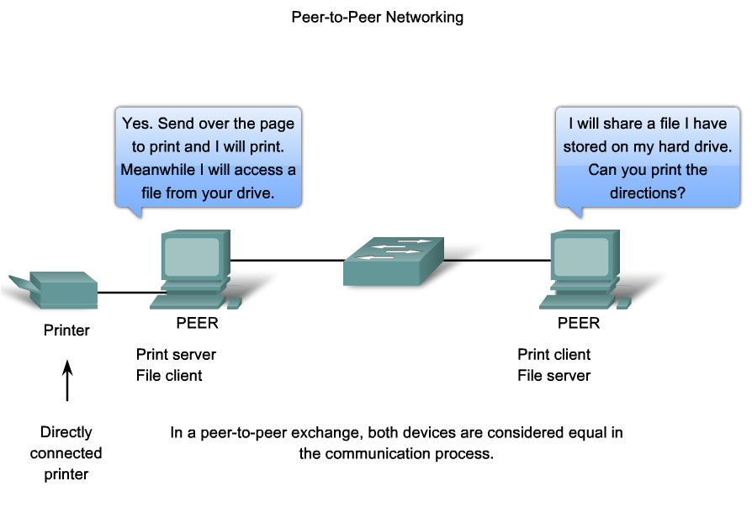
Peer-to-Peer мережі
Рівноправна взаємодія

Slide 24
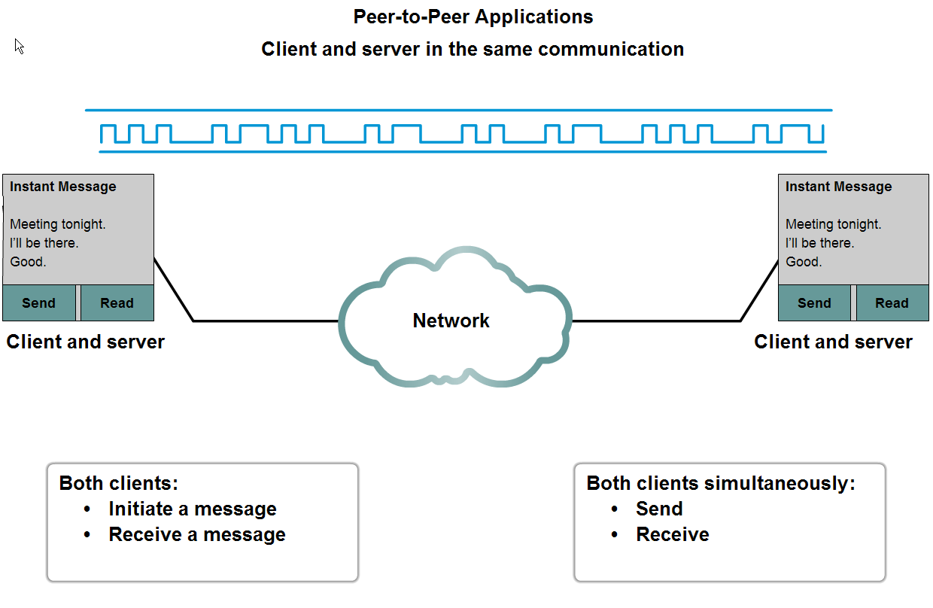
Peer-to-Peer мережі
peer-to-peer мережі та peer-to-peer applications

Slide 25
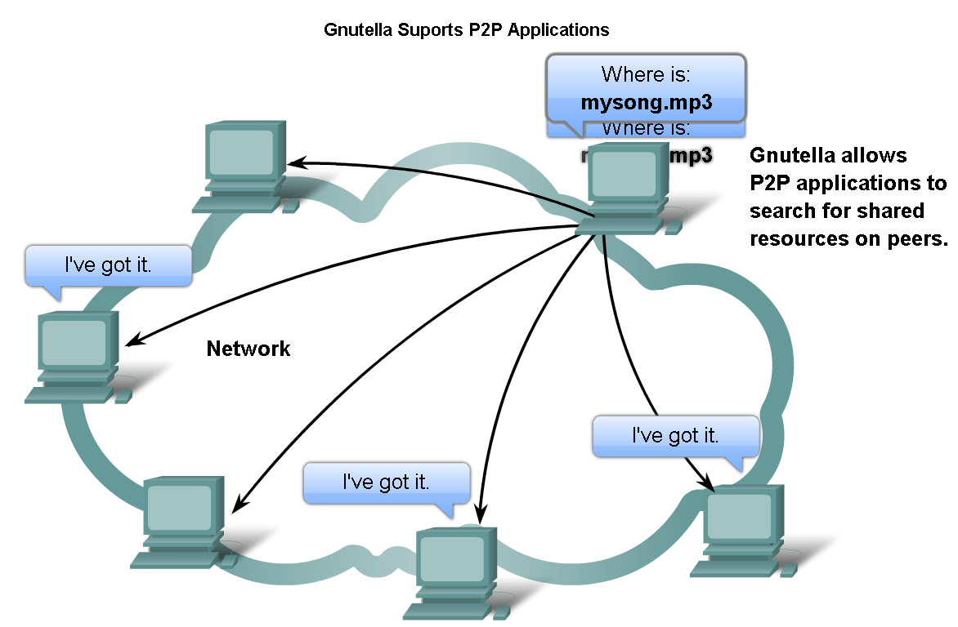
Peer-to-Peer мережі
Протокол Gnutella

Slide 26
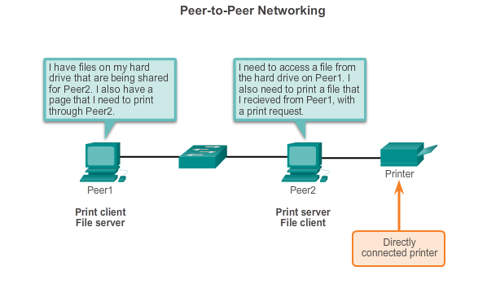
How Application Protocols Interact with End-User Applications Peer-to-Peer Networks
Both devices are considered equal in the communication
The roles of client and server are set on a per request basis.
Notes:
10.1.2.1
Two or more computers are connected via a network and can share resources (such as printers and files) without having a dedicated server. Every connected end device (known as a peer) can function as both a server and a client. The roles of client and server are set on a per request basis.
In this example, Peer1 has a printer attached to it directly by USB, and is setup to share the printer on the network so that Peer2 can print to it. The Peer2 is setup to share a drive or folder on the network. This allows Peer1 to access files on the shared folder, as well as save files to the shared folder. In addition to sharing files, a network such as this one would allow users to enable networked games, or share an Internet connection.
Peer-to-peer networks decentralize the resources on a network. Instead of locating data to be shared on dedicated servers, data can be located anywhere and on any connected device

Slide 27
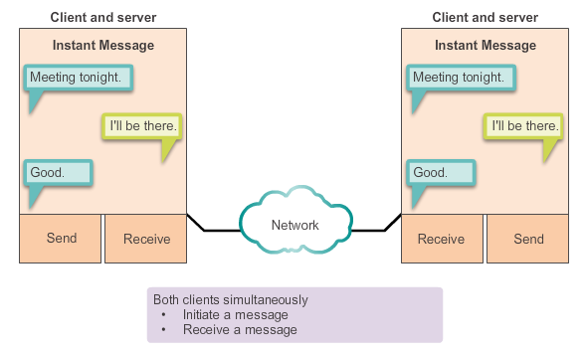
How Application Protocols Interact with End-User Applications Peer-to-Peer Applications
Client and server in the same communication
Both can initiate a communication and are considered equal in the communication process
Notes:
10.1.2.2
Peer-to-peer applications can be used on peer-to-peer networks, client-server networks, and across the Internet.

Slide 28
How Application Protocols Interact with End-User Applications Common P2P Applications
With P2P applications, each computer in the network running the application can act as a client or a server for the other computers in the network running the application
Common P2P applications include:
eDonkey
eMule
Shareaza
BitTorrent
Bitcoin
LionShare
Some P2P applications are based on the Gnutella protocol which enables people to share files on their hard disks with others
Notes:
10.1.2.3
Many P2P applications do not use a central database to record all the files available on the peers. Instead, the devices on the network each tell the others what files are available when queried, and use the file sharing protocol and services to support locating resources.

Slide 29
Application Layer Protocols Revisited
Three application layer protocols that are involved in everyday work or play are:
Hypertext Transfer Protocol (HTTP)
browse the web
Simple Mail Transfer Protocol (SMTP)
used to enable users to send email
Post Office Protocol (POP)
used to enable users to receive email
Notes:
10.2.1.1

Slide 30
Common Application Layer Protocols Hypertext Transfer Protocol / Markup Language
Example
URL: http://www.cisco.com/index.html
First, the browser interprets the three parts of the URL:
1. http (the protocol or scheme)
2. www.cisco.com (the server name)
3. index.html (the specific file name requested)
Browser checks with a name server to convert www.cisco.com into a numeric address
Using the HTTP protocol requirements sends a GET request to the server and asks for the file index.html
Server sends the HTML code for this web page
Browser deciphers the HTML code and formats the page
Notes:
10.2.1.2

Slide 31
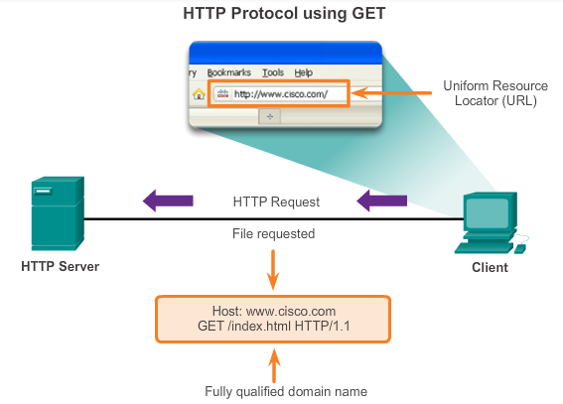
Common Application Layer Protocols HTTP and HTTPS
Developed to publish and retrieve HTML pages
Used for data transfer
Specifies a request/response protocol
Three common message types are GET, POST, and PUT
GET is a client request for data
POST and PUT are used to send messages that upload data to the web server
Notes:
10.2.1.3

Slide 32
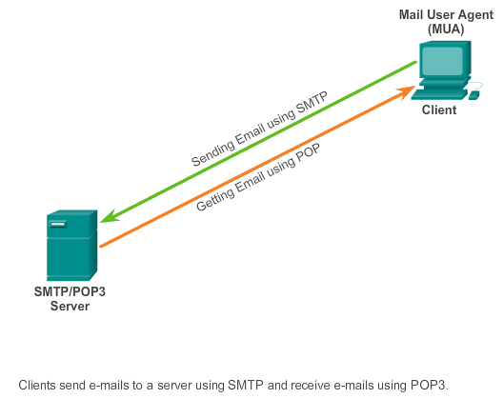
Common Application Layer Protocols SMTP, POP, and IMAP
Typically use an application called a Mail User Agent (email client)
Allows messages to be sent
Places received messages into the client's mailbox
SMTP - Send email from either a client or a server
POP - Receive email messages from an email server
IMAP - Internet Message Access Protocol
Email client provides the functionality of both protocols within one application
Notes:
10.2.1.4

Slide 33
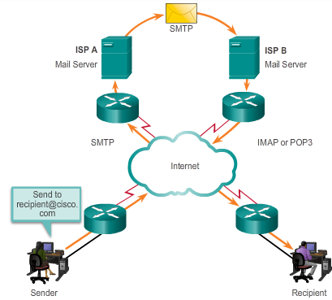
Common Application Layer Protocols SMTP, POP, and IMAP
Notes:
10.2.1.4

Slide 34
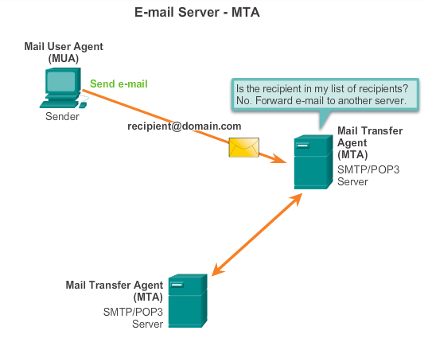
Common Application Layer Protocols SMTP, POP, and IMAP (Continued)
Simple Mail Transfer Protocol (SMTP)
transfers mail
message must be formatted properly
SMTP processes must be running on both the client and server
message header must have a properly formatted recipient email address and a sender
uses port 25
Notes:
10.2.1.5

Slide 35
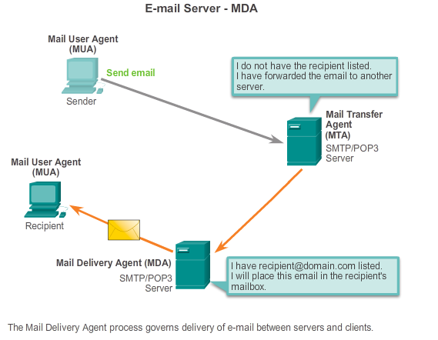
Common Application Layer Protocols SMTP, POP, and IMAP (Continued)
Post Office Protocol (POP)
enables a workstation to retrieve mail from a mail server
mail is downloaded from the server to the client and then deleted on the server
uses port 110
POP does not store messages
POP3 is desirable for an ISP, because it alleviates their responsibility for managing large amounts of storage for their email servers
Notes:
10.2.1.6

Slide 36
Common Application Layer Protocols SMTP, POP, and IMAP (Continued)
Simple Mail Transfer Protocol (SMTP)
Transfers mail reliably and efficiently
Post Office Protocol (POP)
Enables a workstation to retrieve mail from a mail server
With POP, mail is downloaded from the server to the client and then deleted on the server
Internet Message Access Protocol (IMAP)
Another protocol that to retrieves email messages
Unlike POP, when the user connects to an IMAP-capable server, copies of the messages are downloaded to the client application
Original messages are kept on the server until manually deleted
Notes:
10.2.1.7

Slide 37
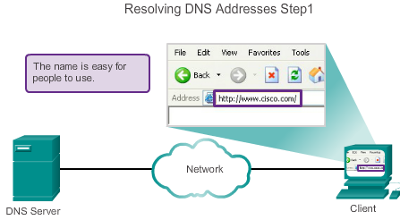
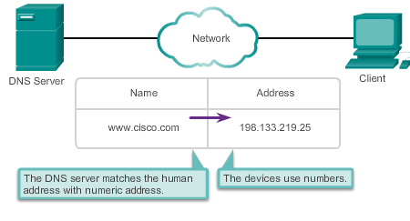
Providing IP Addressing Services Domain Name Service
A human legible name is resolved to its numeric network device address by the DNS protocol
Notes:
10.2.2.1

Slide 38
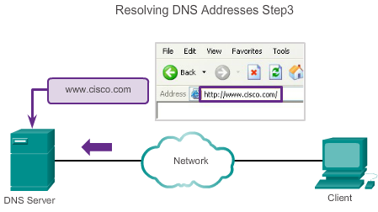

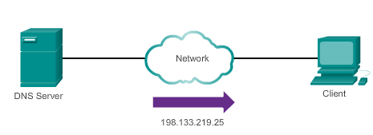

Providing IP Addressing Services Domain Name Service
A human legible name is resolved to its numeric network device address by the DNS protocol
Notes:
10.2.2.1

Slide 39
Providing IP Addressing Services DNS Message Format
DNS server stores different types of resource records used to resolve names
Contain the name, address, and type of record
Record types are:
A - an end device address
NS - an authoritative name server
CNAME - the canonical name for an alias; used when multiple services have the single network address but each service has its own entry in DNS
MX - mail exchange record; maps a domain name to a list of mail exchange servers
Unable to resolve the name using its stored records, contacts other servers
Server temporarily stores the numbered address that matches the name in cache memory
Windows ipconfig /displaydns displays all cached DNS
Notes:
10.2.2.2

Slide 40
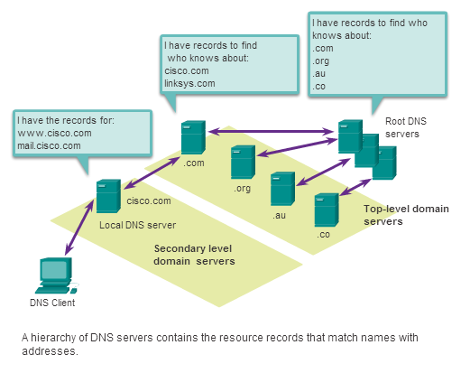
Providing IP Addressing Services DNS Hierarchy
Examples top-level domains:
.au - Australia
.co - Colombia
.com - business or industry
.jp - Japan
.org - non-profit organization
Notes:
10.2.2.3

Slide 41
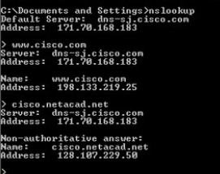
Providing IP Addressing Services nslookup
Operating system utility called nslookup allows the user to manually query the name servers to resolve a given host name
Utility can be used to troubleshoot name resolution issues and to verify the current status of the name servers
Notes:
10.2.2.4

Slide 42
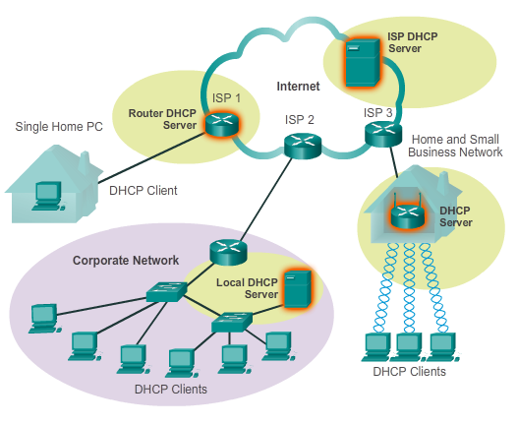
Providing IP Addressing Services Dynamic Host Configuration Protocol
DHCP allows a host to obtain an IP address dynamically
DHCP server is contacted and address requested - chooses address from a configured range of addresses called a pool and “leases” it to the host for a set period
DHCP used for general purpose hosts such as end user devices, and static addressing is used for network devices such as gateways, switches, servers and printers
Notes:
10.2.2.6

Slide 43
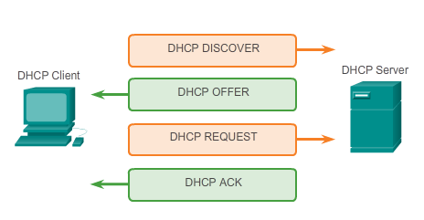
Providing IP Addressing Services DHCP Operation
Notes:
10.2.2.7

Slide 44
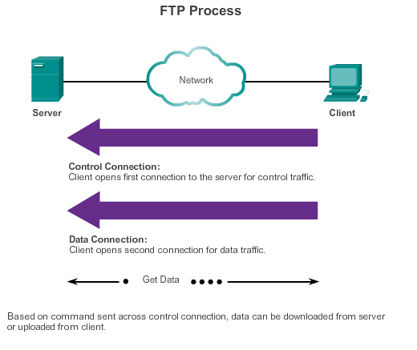
Providing File Sharing Services File Transfer Protocol
FTP allow data transfers between a client and a server
FTP client is an application that runs on a computer that is used to push and pull data from a server running an FTP daemon
To successfully transfer data, FTP requires two connections between the client and the server, one for commands and replies, the other for the actual file transfer
Notes:
10.2.3.1

Slide 45
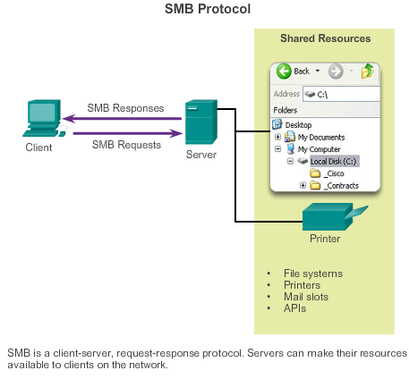
Providing File Sharing Services Server Message Block
Clients establish a long term connection to servers
After the connection is established, the user can access the resources on the server as if the resource is local to the client host
Notes:
10.2.3.4

Slide 46
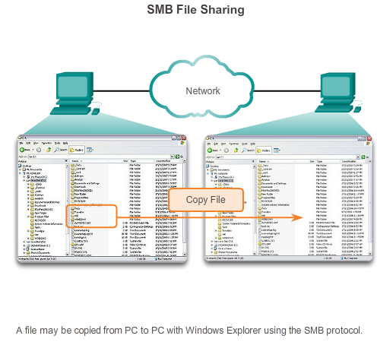
Providing File Sharing Services Server Message Block
Notes:
10.2.3.4

Slide 47
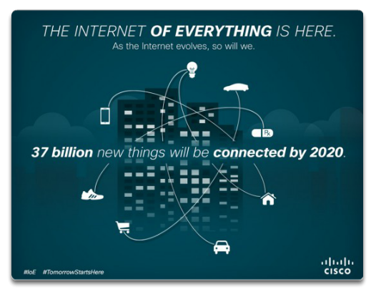
Move It! The Internet of Things
Notes:
10.3.1.1

Slide 48
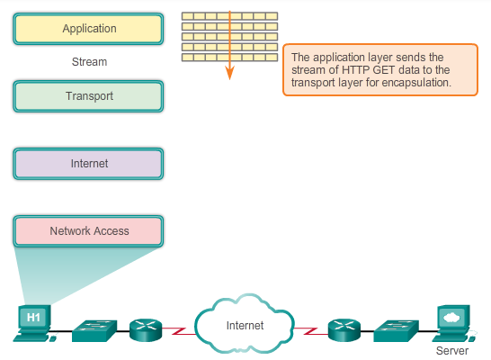
Move It! Message Travels Through a Network
Notes:
10.3.1.2

Slide 49
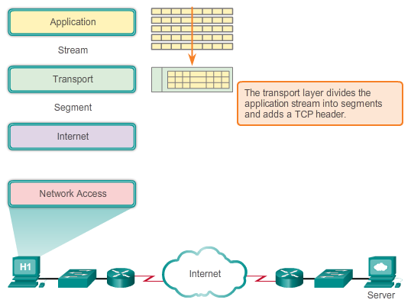
Move It! Message Travels Through a Network
Notes:
10.3.1.2

Slide 50
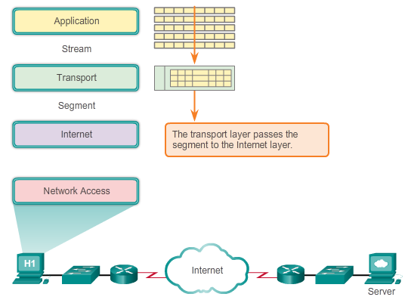
Move It! Message Travels Through a Network
Notes:
10.3.1.2

Slide 51
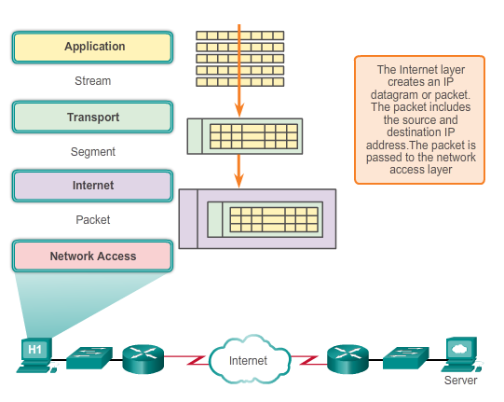
Move It! Getting the Data to the End Device
Notes:
10.3.1.3

Slide 52
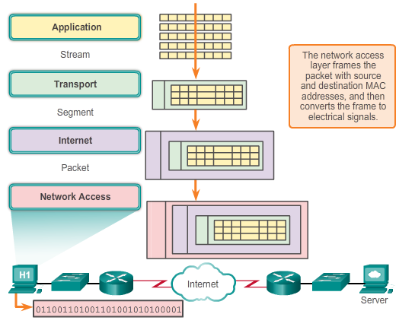
Move It! Getting the Data through the Internetwork
Notes:
10.3.1.4

Slide 53
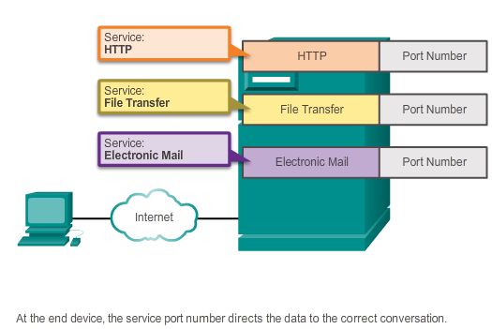
Move It! Getting the Data to the Right Application
Notes:
10.3.1.5

Slide 54
Application Layer Summary
Applications are computer programs with which the user interacts and which initiate the data transfer process at the user’s request.
Services are background programs that provide the connection between the application layer and the lower layers of the networking model.
Protocols provide a structure of agreed-upon rules and processes that ensure services running on one particular device can send and receive data from a range of different network devices.
Notes:
Section 1.5 & 1.5.1

Slide 55
Application Layer Summary
HTTP supports the delivery of web pages to end devices
SMTP, POP, and IMAP support sending and receiving email
SMB and FTP enable users to share files
P2P applications make it easier for consumers to seamlessly share media
DNS resolves the human legible names used to refer to network resources into numeric addresses usable by the network
All of these elements work together, at the application layer.
The application layer enables users to work and play over the Internet.
Notes:
Section 1.5 & 1.5.1

Slide 56
Підсумки
Клієнти і сервери використовують протоколи і стандарти для обміну інформацією
Клієнт-серверні послуги ідентифікуються на основі номерів портів.
Стек протоколів організовує протоколів по рівнях, причому кожен рівень надає та отримує послуги від нижчого та вищого рівнів

